Slide 1

Session 07
ADO.NET Entity Framework

Slide 2
Objectives
Explain the ADO.NET Entity Framework
Describe Entity Data Model (EDM)
Describe creation of a simple Entity Data Model
Describe creation of a Windows Forms Data Source using EDM
Describe data retrieval using the EDM
Using Store Procedure with ADO.NET Entity Framework

Slide 3
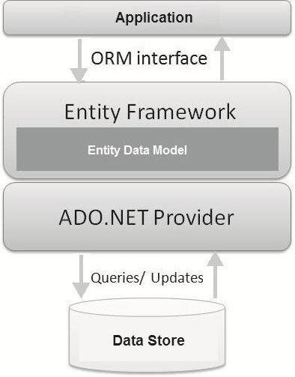
ADO.NET Entity Framework
Introduced with Visual Studio 2008 and ADO.NET 3.5
An Object-Relational Mapping (ORM) framework consisting of a data model and a set of design-time and run-time services
Enables to run queries using LINQ and retrieve and manipulate data in the form of strongly typed objects
Enables writing .NET applications against classes generated from the conceptual layer
An entity is a concept in the domain of an application from which a data type is defined

Slide 4
ADO.NET Entity Framework - Advantages
Lesser development time
Capabilities and benefits of LINQ can be leveraged through LINQ to Entities
LINQ support enables the use of IntelliSense and helps to validate query syntax based on the conceptual model at compile-time
Exposes data as strongly typed objects so that inheritance and reflection features can be used
Work with applications that support a conceptual model independent of the physical/storage model
No need to frequently change the application code whenever any mapping between the object model and the storage-specific schema changes

Slide 5
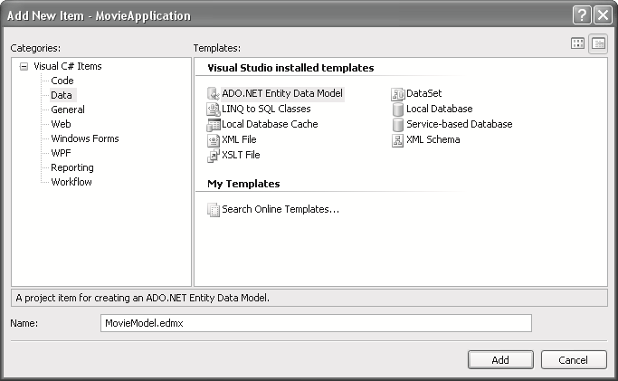
Creating a Windows Forms Data Source using Entity Data Model 1-10
Step by step procedure to use the ADO.NET Entity Framework in a Windows Forms application
Launch Visual Studio 2008.
Create a new application or open an existing one.
Select Project 🡪Add New Item. This displays the Add New Item dialog box.
Select ADO.NET Entity Data Model. Rename the Model1.edmx to MovieModel.edmx as shown in the figure.

Slide 6
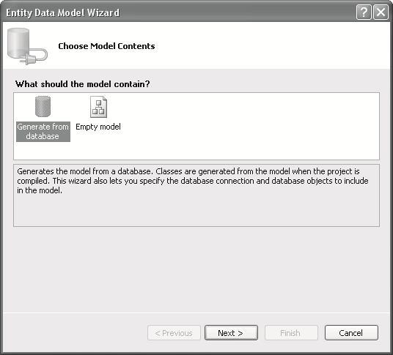
Creating a Windows Forms Data Source using Entity Data Model 2-10
Click Add. This displays the Entity Data Model Wizard as shown in the figure.

Slide 7
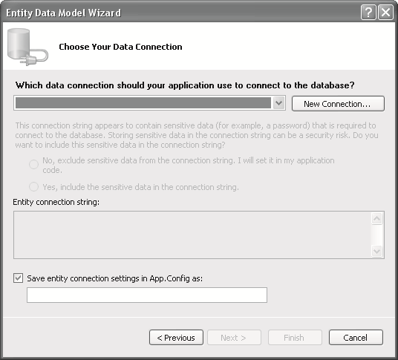
Creating a Windows Forms Data Source using Entity Data Model 3-10
Select Generate from Database. This launches the Choose Your Data Connection page as shown in the figure.
Click New Connection.

Slide 8
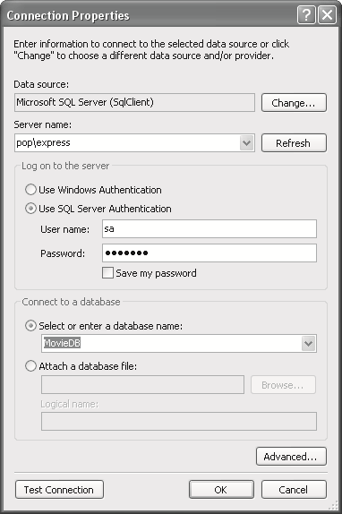
Creating a Windows Forms Data Source using Entity Data Model 4-10
Enter the SQL Server details as shown in the figure.
Click OK.

Slide 9
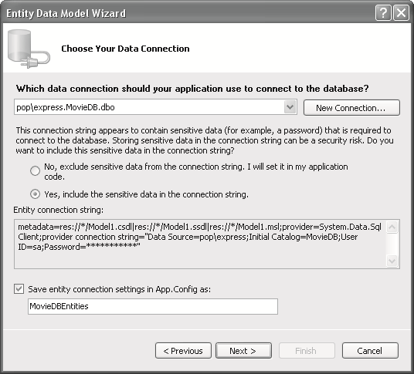
Creating a Windows Forms Data Source using Entity Data Model 5-10
This will populate the connection details as shown in the figure.
Click the option button Yes, include the sensitive data in the connection string. It is recommended that you always click the No, exclude…option button but for the sake of this example, you click Yes,...
Click Next.

Slide 10
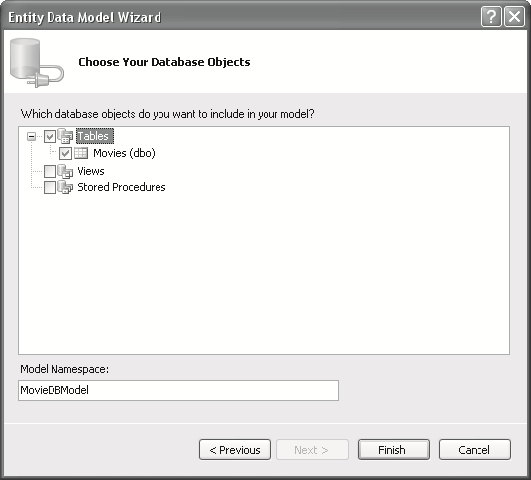
Creating a Windows Forms Data Source using Entity Data Model 6-10
This will display the Choose Your Database Objects page as shown in the figure.

Slide 11
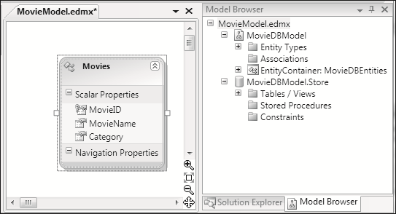
Creating a Windows Forms Data Source using Entity Data Model 7-10
In the Choose Your Database Objects dialog box, specify the table name to include in the data model. Select the Movies table and click Finish. This results in the EDM as shown in the figure.

Slide 12
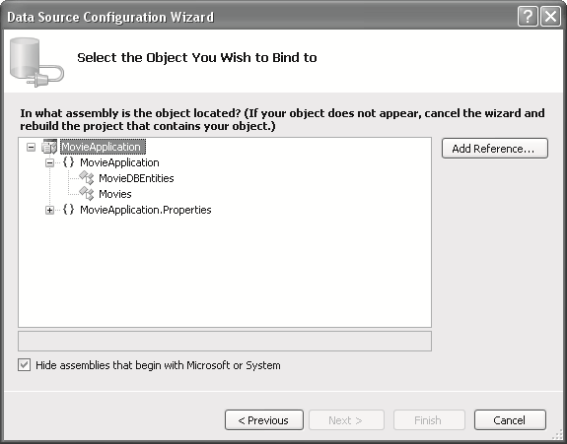
Creating a Windows Forms Data Source using Entity Data Model 8-10
Using the EDM in the Windows Forms application
Add a new data source using Add Data Source option from the Data menu. This displays the Data Source Configuration Wizard.
Select Object as the Data Source type.
Click Next. The next page displays the namespaces and classes that are available in the solution as a tree-like structure.
Expand the tree node on the namespace to see the various classes. The figure shows the outcome.

Slide 13
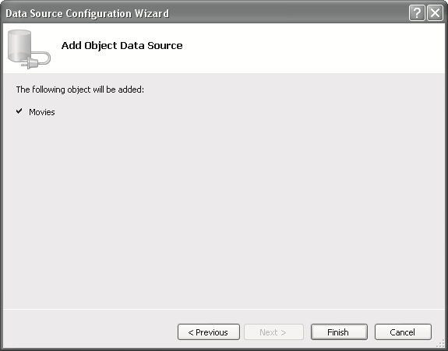
Creating a Windows Forms Data Source using Entity Data Model 9-10
Select the assembly based on which you want to create the Object Data Source. In this case, select Movies. The object, Movies, will be added as shown in the figure.
View the data source. Drag and drop the Movies data source from the Data Sources window to the form. This will auto-generate a DataGridView with a BindingSource and a BindingNavigator and bind them.

Slide 14
Creating a Windows Forms Data Source using Entity Data Model 10-10
Assume that a form, frmDataTest, is created. Generate the Load event for the Form. Copy the following code into the form’s Load event handler to access the Movies entity and bind to the database.
Snippet
MovieDBEntities mve;
private void frmDataTest_Load(object sender, EventArgs e)
{
mve = new MovieDBEntities();
var movies = mve.Movies;
moviesBindingSource.DataSource = movies;
}

Slide 15
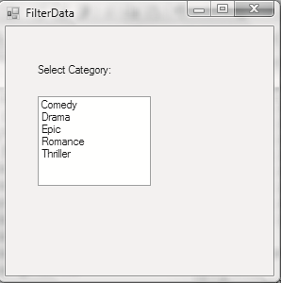
Querying the Entity Data Model
Output
Consider that you have an additional form named frmFilterData in your application. This form contains a ListBox into which you want to load all the categories of movies from the Movies database. To retrieve only the unique values, you will need to use the Distinct standard LINQ operator. Therefore, the following code is to be added.
Snippet
MovieDBEntities mve;
private void frmFilterData_Load(object sender, EventArgs e)
{
mve = new MovieDBEntities();
var categories = from movie in mve.Movies
select movie.Category;
var distinctCategories = categories.Distinct();
lstCategory.Items.AddRange(distinctCategories.ToArray());
}

Slide 16
Using Stored Procedures with the ADO.NET Entity Framework
Creating the SELECT stored procedure(s)
Layout of the ArticleView form
Importing the stored procedure
Using the stored procedure to get entities in our code
Another stored procedure, and using it
Navigation and update code

Slide 17
Summary and Workshop
ADO.NET Entity Framework is an Object-Relational Mapping (ORM) framework integrated into Visual Studio 2008.
The Entity Data Model (EDM) is an Entity-Relationship data model used in ADO.NET Entity Framework that describes the application-specific objects.

Slide 18

THANKS FOR WATCHING !

